Slide 1
FREE
MELBOURNE CITY CHURCH

Slide 2
Would you believe me if I said that we are the ones
who can make the change in the world today

Slide 3
Would you believe me if I said that all of your dreams
in your heart can come true today

Slide 4
Would you believe me if I said that life could be
all that you want it to be
today

Slide 5
And if I had wings I would fly 'Cause all that I need, You are And if the world caved in
around me to You
I'd still hold on

Slide 6
Cause You're all that I believe And the one that created me Jesus because of You
I'm free

Slide 7
Would you believe me if I said that God can make
miracles happen
today

Slide 8
Would you believe me if I said that you don't need to wait for the answers before you step out in faith

Slide 9
Would you believe me if I said that nothing is
ever impossible
for God

Slide 10
And if I had wings I would fly 'Cause all that I need, You are And if the world caved in
around me to You
I'd still hold on

Slide 11
Cause You're all that I believe And the one that created me Jesus because of You
I'm free

Slide 12
Just live your life
with God inside You wont regret
one moment of it

Slide 13
And
give all that you can
for God, for God

Slide 14
주 사랑이 내게 들어와
MELBOURNE CITY CHURCH

Slide 15
내 입술이 주를 높이며
내 호흡이 주를 섬기니
무엇이 나를 두렵게 하리

Slide 16
주 잠잠히 나를 비추며
주 가득히 나를 채우니
무엇도 나를 흔들지 못하리

Slide 17
주 사랑이 내게 들어와
모든 두렴 사라지게 해
영원히 주 찬양 찬양
내 영혼 춤추리

Slide 18
주 사랑이 내게 들어와
모든 두렴 사라지게 해
영원하신 그의 사랑 안에
나 거하리

Slide 19
나 가진 것 없지만
내 안에 기쁨이 넘쳐 흐르네
나 작은 자 같지만
내 안에 빛이 눈 먼 땅을 비추리

Slide 20
Jesus lover of my soul
MELBOURNE CITY CHURCH

Slide 21
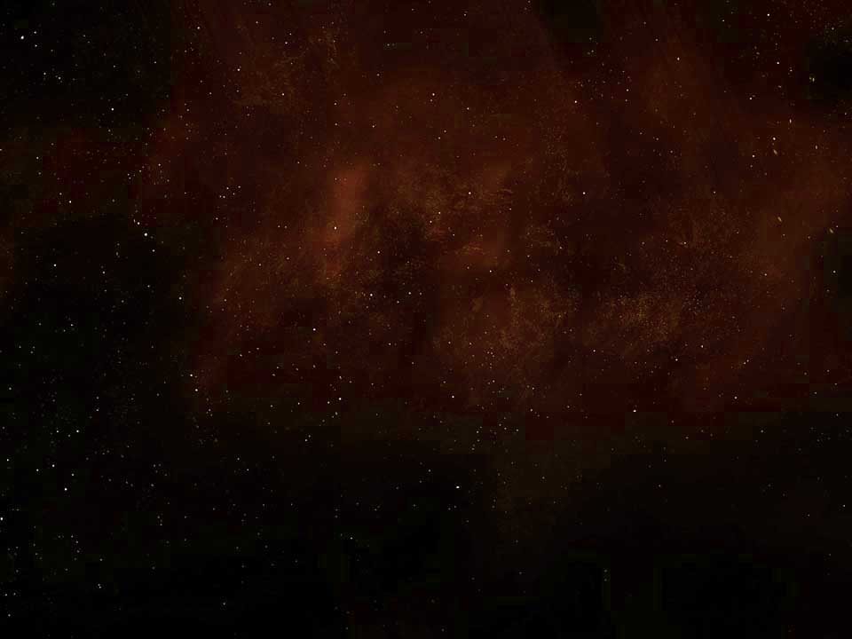
Jesus,
lover of my soul
Jesus,
I will never let You go

Slide 22
You've taken me
from the miry clay You've set my feet
upon the rock And now I know

Slide 23
I love you I need you Though my world may fall
I'll never let You go

Slide 24
My Saviour My closest Friend I will worship You
until the very end

Slide 25
나의 영혼이
MELBOURNE CITY CHURCH

Slide 26
나의 영혼이 잠잠히
하나님만 바람이여 나의 구원이 그에게서
나는도다
Wait O my soul in silence
Wait for Almighty God alone
My salvation will come from him
Who cares for me

Slide 27
나의 영혼아 잠잠히
하나님만 바라라 나의 소망이 저에게서
나는도다
Wait O my soul in silence
Wait for Almighty God alone
What I’m hoping for will come from him
Who cares for me

Slide 28
오직 주만이 나의 반석
나의 구원이시니 오직 주만이 나의 산성
내가 요동치 아니하리
The Almighty God is the only Rock
My salvation is the Lord
The Almighty God is my Fortress
On this Rock of Ages I will stand

Slide 29
나의 영혼이 간절히
여호와를 갈망하며 나의 입술이 여호와를
찬양하리
Look O my soul in earnest
Look to Almighty God alone
My lips will sing the glorious praise
Of him alone

Slide 30
나의 영혼이 즐거이
여호와를 따르리니 나의 평생에 여호와를
송축하리
Walk O my soul with gladness
Walk with Almighty God alone
The remaining days of my life
I will bless the Lord

Slide 31
오직 주만이 나의 반석
나의 구원이시니 오직 주만이 나의 산성
내가 요동치 아니하리
The Almighty God is the only Rock
My salvation is the Lord
The Almighty God is my Fortress
On this Rock of Ages I will stand

Slide 32
나의 구원 나의 영광
하나님께 있으니 내힘의 반석과
피난처 되시네
My salvation and my glory
Firmly anchored in the Lord
He’s my Strength, he’s my Rock
He is my Hiding Place

